Slide 1


Data Analysis
Python for data science

Slide 2

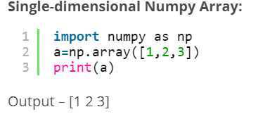
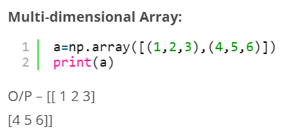
Introduction to NumPy
NumPy Basics:
NumPy is a library written for scientific computing and data analysis. It stands for numerical python.
The most basic object in NumPy is simply an array which is an n-dimensional, homogeneous array. By homogenous, we mean that all the elements in a NumPy array have to be of the same data type, which is commonly numeric (float or integer).
Arrays in NumPy: NumPy’s main object is the homogeneous multidimensional array.

Slide 3

Introduction to pandas
Pandas is a library built using NumPy specifically for data analysis. You'll be using Pandas heavily for data manipulation, visualization, building machine learning models, etc.
There are two main data structures in Pandas - Series and Data frames. The default way to store data is data frames, and thus manipulating data frames quickly is probably the most important skill set for data analysis.
The Pandas Series (similar to a NumPy array)
Creating a Pandas series.
Indexing series.
Data frames
Creating data frames from dictionaries.
Importing CSV data files as Pandas data frames.
Reading and summarising data frames.
Sorting data frames.

Slide 4
Pandas Basics
pandas series
A series is similar to a 1-D NumPy array, and contains scalar values of the same type (numeric, character, datetime etc.). A data frame is simply a table where each column is a pandas series.
Pandas Data frame
Data frame is the most widely used data-structure in data analysis. It is a table with rows and columns, with rows having an index and columns having meaningful names.
Creating data frames
There are various ways of creating data frames, such as creating them from dictionaries, JSON objects, reading from txt, CSV files, etc.
An important concept in Pandas data frames is that of row indices. By default, each row is assigned indices starting from 0, and are represented at the left side of the data frame.

Slide 5
Reading and Summarising Data frames
After you import a data frame, you'd want to quickly understand its structure, shape, meanings of rows and columns etc. Further, you may want to look at summary statistics - such as mean, percentiles etc.
Looking at the top and bottom entries of data frames.
Looking at the datatypes of each column.
Describe gives you a summary of all the numeric columns in the dataset.
The number of rows and columns.
Sorting data frames
You can sort data frames in two ways - 1) by the indices and 2) by the values.
Sorting by index axis = 0 indicates that you want to sort rows (use axis=1 for columns)
Sorting by values = Sorting in increasing order = df.sort_values(by='col').head()

Slide 6
Indexing and Selecting Data
Selecting Rows
The syntax df[start_index:end_index]will subset rows according to the start and end indices. Selecting rows: df[start: stop] for pulling out the mentioned rows.
Selecting Columns
There are two simple ways to select a single column from a data frame - df['column name'] and df.column_name.
Selecting Multiple Columns
You can select multiple columns by passing the list of column names inside the : df[['column_1', 'column_2']].

Slide 7
Two main ways of indexing data frames:
Position and Label Based Indexing:
Position based indexing : which uses df.iloc[].
Pandas provides the df.iloc functionality to index data frames using integer indices.
Note that 2, 4 corresponds to the third row and fifth column = df.iloc[2, 4]
The ":" indicates "all rows/columns“ = df.iloc[5, :]
Selecting multiple rows and columns = df.iloc[3:6, 2:5]
Selecting a single column = df.iloc[:, 2]
df.iloc[[3, 7, 8], :]
Label based indexing : which uses df.loc[].
Pandas provides the df.loc[] functionality to index data frames using labels.
Selecting a single element = Select row label = 2 and column label = 'co_name’
df.loc[2, 'col_name’]
df.loc[[3, 7, 8], :]

Slide 8
Merging and Concatenating Data frames
Merging is one of the most common operations you will do, since data often comes in various files.
Merge multiple data frames using common columns/keys using pd. merge()
Note that column is the common column/key, which is provided to the 'on' argument how = 'inner' makes sure that only the column present in both dfs are included in the result
pd.merge(df_1, df_2, how='inner', on= 'common_col ‘)
Concatenation is much more straightforward than merging. It is used when you have data frames having the same columns and want to append them (pile one on top of the other), or having the same rows and want to append them side-by-side.
Concatenate data frames using pd.concat()
To concatenate, one on top of the other, you can use pd.concat().
The first argument is a sequence (list) of data frames axis = 0 indicates that we want to concat along the row axis
pd.concat([df1, df2], axis = 1)

Slide 9
Grouping and Summarising Data frames
Grouping and aggregation are some of the most frequently used operations in data analysis, especially while doing exploratory data analysis (EDA), where comparing summary statistics across groups of data is common.
Step 1. Grouping using df.groupby() Typically, you group the data using a categorical variable, such as customer segments, product categories, etc. This creates as many subsets of the data as there will be levels in the categorical variable.
Note that df. group by returns a Data Frame Group By object.
Step 2. Applying a Function After grouping, you apply a function to a numeric variable, such as mean(Sales), sum(Profit) etc. We can choose aggregate functions such as sum, mean, median, etc.
Step 3. Combining the results into a Data Structure, You can optionally show the results as a data frame. Converting to a data frame = pd.DataFrame(grouped_df['col'].sum()).

Slide 10
Lambda function
Use lambda functions to create new and alter existing columns.
for example: Say you want to create a new column indicating whether a given order was profitable or not (1/0).You need to apply a function which returns 1 if Profit > 0, else 0. This can be easily done using the apply() method on a column of the data frame.
we can create a new column using the existing columns in our data frame. Columns which are created by the user are known as 'Derived Variables'. Derived variables increase the information conveyed by the data frame.
for example : df['profit_per_qty'] = df['Profit']/df['Order_Quantity’]

Slide 11
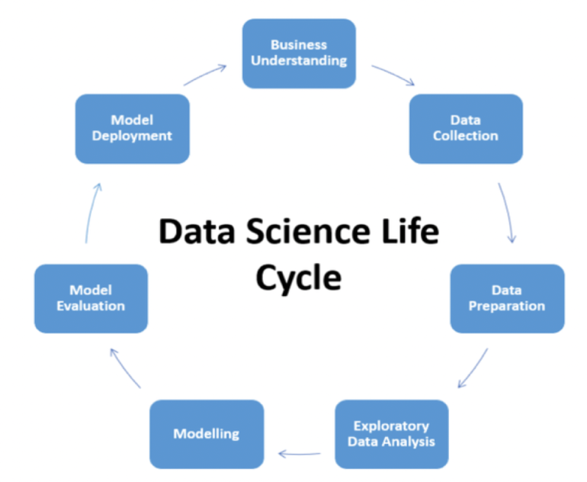

Data Science Project Life Cycle

Slide 12
Life cycle
1. Business Understanding:
Business Understanding plays a key role in the success of any project.
Every domain and business work with a set of rules and goals. In order to acquire the correct data, we should be able to understand the business.
2. Data Collection:
Data could be from various sources which could be – logs from web servers, data from online repositories, data from databases, social media data, data in excel sheets, so in short, data can come from any source.
3. Data Preparation:
Data may be or may not be in the required format. To perform any analytical step on the data it needs to be in a certain format.
It could also be said that data needs to be cleaned before processing any further. Thus, this step is also known as Data Cleaning or Data Wrangling.

Slide 13
Life cycle
4. Exploratory Data Analysis (EDA) plays an important role at this stage as summarization of clean data helps in identifying the structure, outliers, anomalies and patterns in the data. These insights could help in building the model.
5. Data Modelling:
Feature selection is one of the first things that you would like to do in this stage. Not all features might be essential for making predictions.
It should be done such that features contributing to the prediction results should be selected.
It is essential to identify what is the problem, is it a classification problem, regression or prediction problem, time series forecasting or a clustering problem. Once the problem type is sorted out model could be implemented.
6.Model Deployment:
machine learning models are first deployed in a pre-production or test environment before actually deploying them into production.

Slide 14

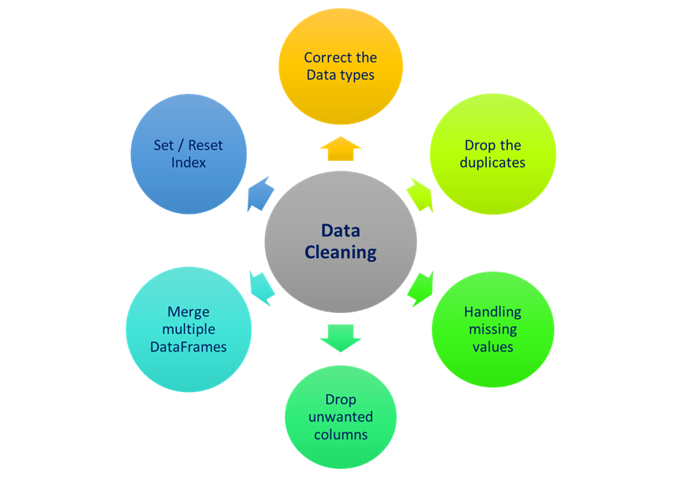
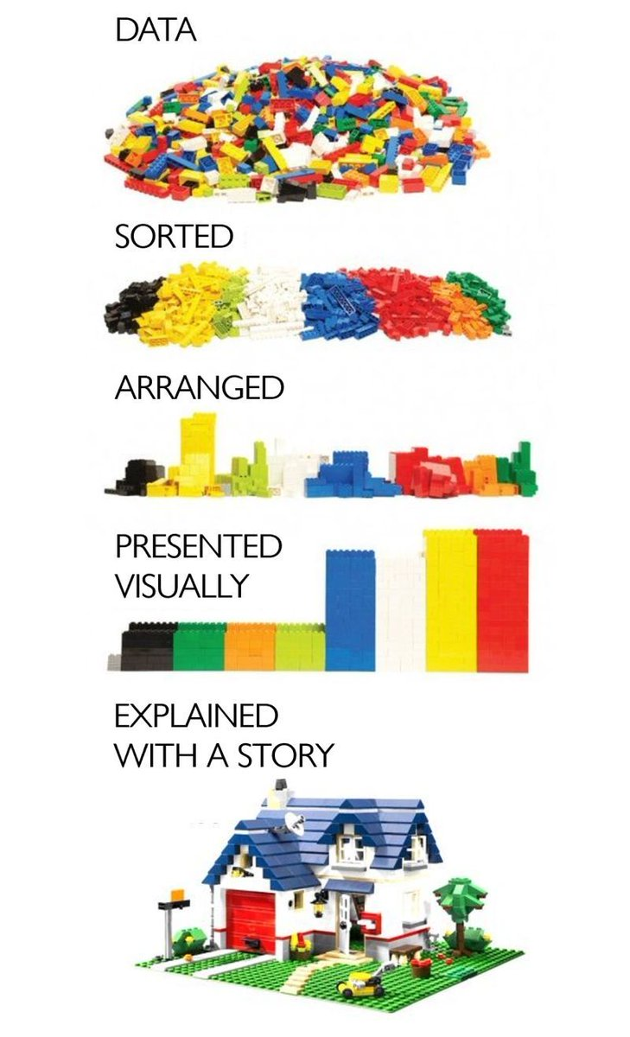
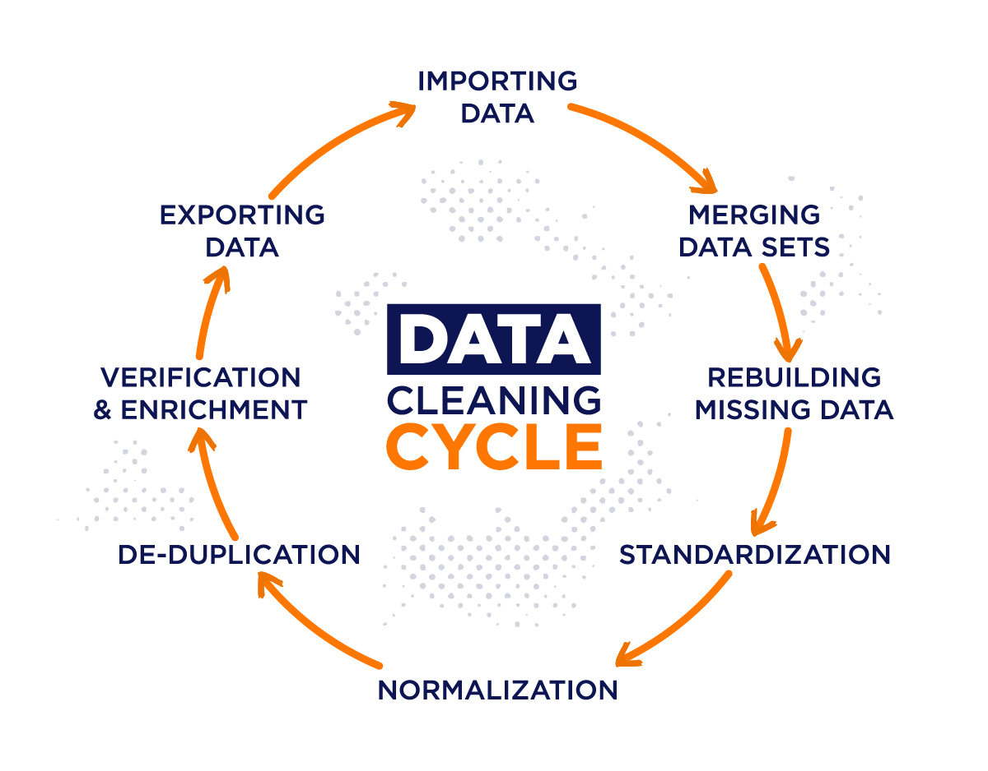

Slide 15
Cleaning Datasets Cleaning Datasets
Handling Missing Data.
Identify missing data in data frames.
Treat (delete or impute) missing values.
In Python, missing data is represented using either of the two objects Nan (Not a Number) or NULL.
There are four main methods to identify and treat missing data:
isnull(): Indicates presence of missing values, returns a Boolean
notnull(): Opposite of isnull(), returns a Boolean
dropna(): Drops the missing values from a data frame and returns the rest
fillna(): Fills (or imputes) the missing values by a specified value

Slide 16
Cleaning Datasets
Identifying Missing Values in Columns
Let's first compute the total number of missing values in the data frame. You can calculate the number of missing values in each column by df.isnull().sum(), summing up the missing values (column-wise).
Note: some columns might have extremely large number of missing values, In such cases, one should be careful in handling missing values, since if you replace them by arbitrary numbers such as mean, median etc., the entire further analysis may throw unrealistic or unexpected results.
It is important that you treat missing values in each column separately, rather than implementing a single solution (e.g. replacing NaNs by the mean of a column) for all columns.

Slide 17
Cleaning Datasets
Treating Missing Values.
There are broadly two ways to treat missing values:
Delete: Delete the missing values.
Impute:
Imputing by a simple statistic: Replace the missing values by another value, commonly the mean, median, mode etc.
Predictive techniques: Use statistical models such as k-NN, SVM etc. to predict and impute missing values
In general, imputation makes assumptions about the missing values and replaces missing values by arbitrary numbers such as mean, median etc. It should be used only when you are reasonably confident about the assumptions.
Otherwise, deletion is often safer and recommended. You may lose some data, but will not make any unreasonable assumptions.

Slide 18
Cleaning Datasets
Note : if columns are having almost 22%, 26%, 57% etc. missing values. When dealing with columns, you would have two simple choices - either delete or retain the column. If you retain the column, you'll have to treat (i.e. delete or impute) the rows having missing values.
If you delete the missing rows, you lose data. If you impute, you introduce bias.
Apart from the number of missing values, the decision to delete or retain a variable depends on various other factors, such as:
the analysis task at hand.
the usefulness of the variable (based on your understanding of the problem).
the total size of available data (if you have enough, you can afford to throw away some of it).
more than 50% missing values. It is impossible to either delete or impute the rows corresponding to such large number of missing values without losing a lot of data or introducing heavy bias.

Slide 19
Cleaning Datasets
Imputation method for categorical columns:
When missing values is from categorical columns then the missing values can be replaced with the most frequent category. If the number of missing values is very large then it can be replaced with a new category.
Using Algorithms that support missing values:
All the machine learning algorithms don’t support missing values but some ML algorithms are robust to missing values in the dataset. The k-NN algorithm can ignore a column from a distance measure when a value is missing. Naive Bayes can also support missing values when making a prediction. These algorithms can be used when the dataset contains null or missing values.
Predicting The Missing Values:
Using the features which do not have missing values, we can predict the nulls with the help of a machine learning algorithm. This method may result in better accuracy, unless a missing value is expected to have a very high variance.
We will be using linear regression to replace the nulls in the feature ‘col’, using other available features. One can experiment with different algorithms and check which gives the best accuracy instead of sticking to a single algorithm.

Slide 20
Encoding Categorical Data
Introduction: Since most machine learning models only accept numerical variables, preprocessing the categorical variables becomes a necessary step. We need to convert these categorical variables to numbers such that the model can understand and extract valuable information.
Categorical variables are usually represented as ‘strings’ or ‘categories’.
There are several different types of categorical data including:
Binary: A variable that has only 2 values. For example, True/False or Yes/No.
Ordinal: A variable that has some order associated with it. for example Place: First, Second, Third.
Techniques:
Label Encoding or Ordinal Encoding
One hot Encoding

Slide 21
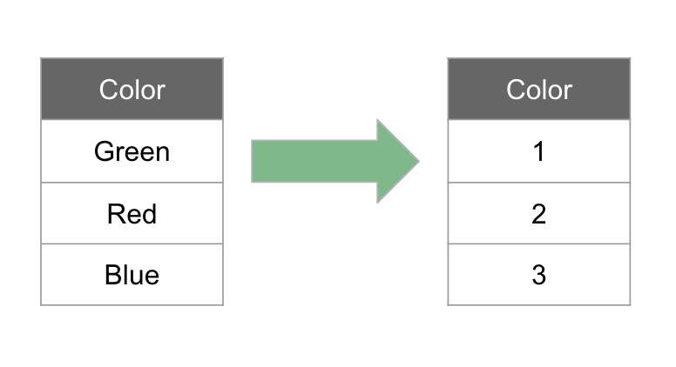
Encoding Categorical Data
Ordinal Feature Encoding:
Ordinal features are those with some order associated with them.
We can encode data with label Encoder():
from sklearn.preprocessing import LabelEncoder.
label encoder can't handle missing values.
label_encoder = LabelEncoder()
ordinal_features['ord_1'] = label_encoder.fit_transform(ordinal_features['ord_1'])
We use this categorical data encoding technique when the categorical feature is ordinal. In this case, retaining the order is important. Hence encoding should reflect the sequence.
Label Encoder() is the fact that the documentation states it should be used for encoding target values (y) and not for the inputs (x).

Slide 22
Encoding Categorical Data
Nominal Features: Nominal features are categorical features that have no numerical importance. An order does not matter.
One Hot Encoding:
We use this categorical data encoding technique when the features are nominal.
In one hot encoding, for each level of a categorical feature, we create a new variable.
Each category is mapped with a binary variable containing either 0 or 1.
These newly created binary features are known as Dummy variables.
Here we can use pandas get_dummies() to one hot encode our nominal features.
This method converts a categorical variable to dummy variables and returns a data frame.
The drop_first parameter is helpful to get k-1 dummies by removing the first level.
nominal_features = pd.get_dummies(nominal_features, drop_first=True)

Slide 23
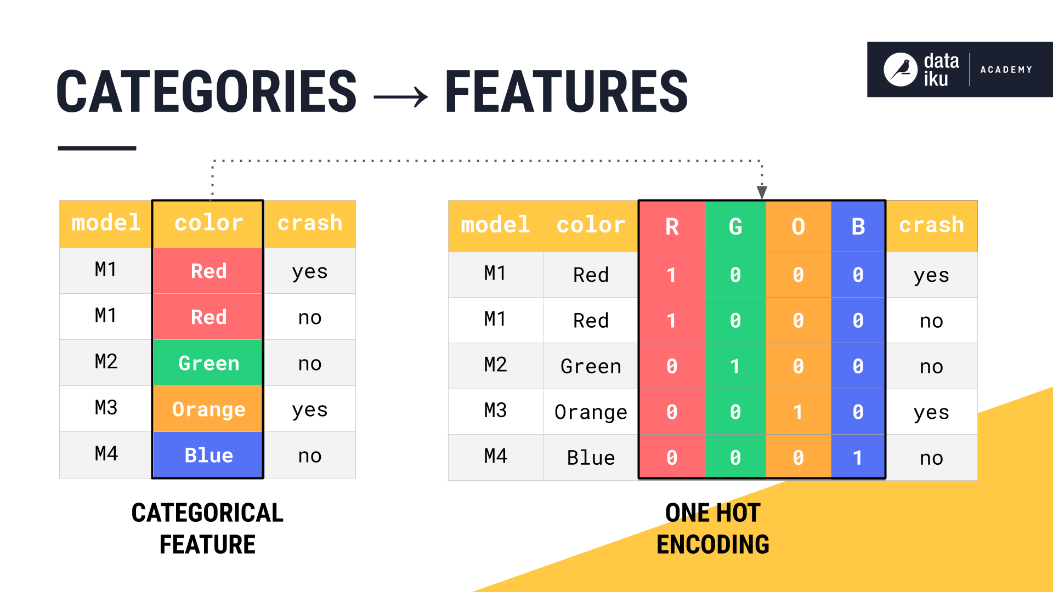
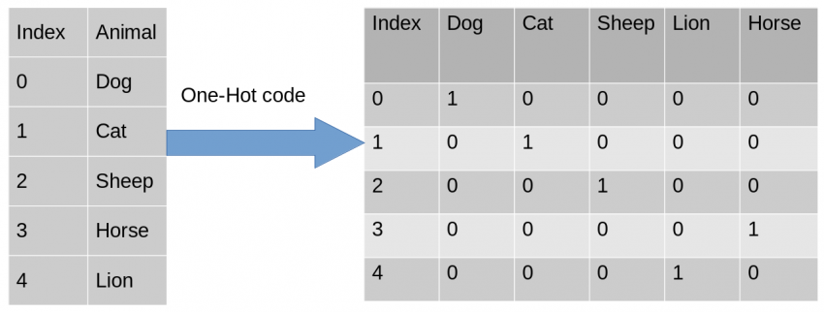
Encoding Categorical Data

Slide 24
Feature Scaling
The goal of applying Feature Scaling is to make sure features are on almost the same scale so that each feature is equally important and make it easier to process by most ML algorithms.
Normalization and standardization: These are two techniques for feature scaling.
Standardization:
The result of standardization is that the features will be rescaled to ensure the mean and the standard deviation be 0 and 1.
This technique is to re-scale features value with the distribution value between 0 and 1 is useful for the optimization algorithms, such as gradient descent, that are used within machine learning algorithms that weight inputs (e.g., regression and neural networks).
Code
from sklearn.preprocessing import StandardScaler
sc= StandardScaler()
sc = sc.fit_transform(df)

Slide 25
Feature Scaling
Max-Min Normalization:
Another common approach is the so-called Max-Min Normalization (Min-Max scaling).
This technique is to re-scale features with a distribution value between 0 and 1.
For every feature, the minimum value of that feature gets transformed into 0, and the maximum value gets transformed into 1.
Code
from sklearn.preprocessing import MinMaxScaler
scaler = MinMaxScaler()
scaler.fit(train_data)
scaled_features = scaler.transform(test_data)
You can always start by fitting your model to raw, normalized and standardized data and compare the performance for best results.
It is a good practice to fit the scaler on the training data and then use it to transform the testing data. This would avoid any data leakage during the model testing process. Also, the scaling of target values is generally not required.

Slide 26
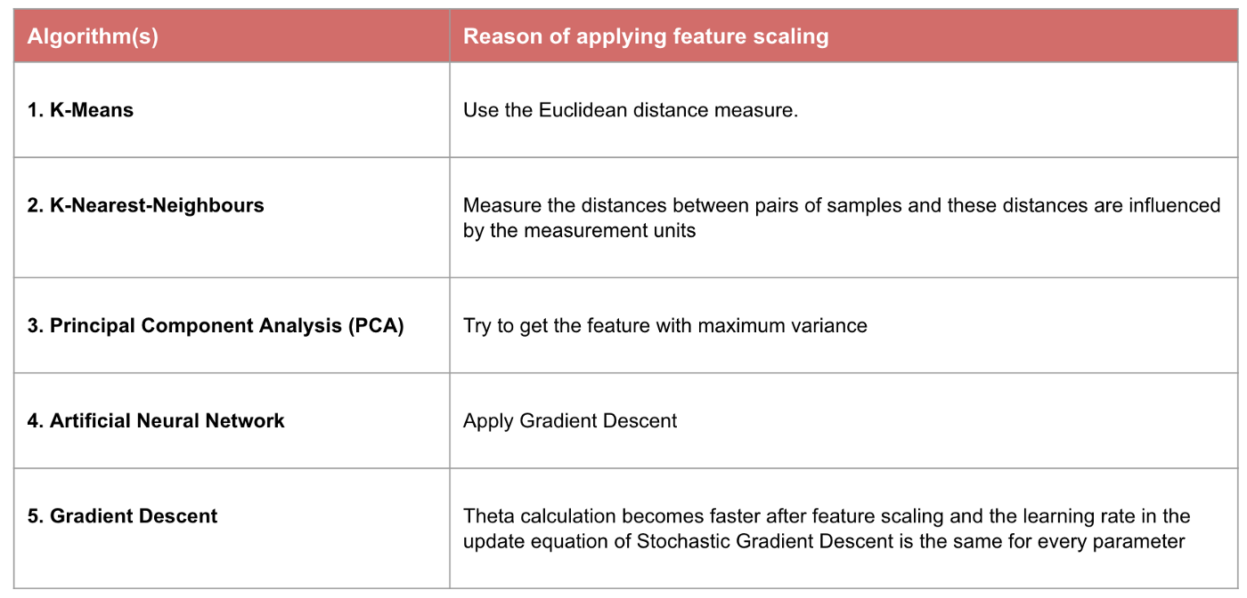
Feature Scaling
When Feature Scaling matters:
Some machine learning models are fundamentally based on distance matrix, also known as the distance-based classifier, for example, K-Nearest-Neighbors, SVM, and Neural Network.
Feature scaling is extremely essential to those models, especially when the range of the features is very different.
Note: If an algorithm is not distance-based, feature scaling is unimportant, including Naive Bayes, Linear Discriminant Analysis, and Tree-Based models (gradient boosting, random forest, etc.).

Slide 27
Data Visualisation
Python for data science

Slide 28

Matplotlib
Data visualization is an important skill to possess for anyone trying to extract and communicate insights from data.
In the field of machine learning, visualization plays a key role throughout the entire process of analysis - to obtain relationships, observe trends and portray the final results as well.
What is Matplotlib?
Matplotlib is a low-level graph plotting library in python that serves as a visualization utility.
Once Matplotlib is installed, import it into your applications by adding the import matplotlib.
Most of the Matplotlib utilities lies under the pyplot submodule, and are usually imported under the plt alias: import matplotlib.pyplot as plt

Slide 29
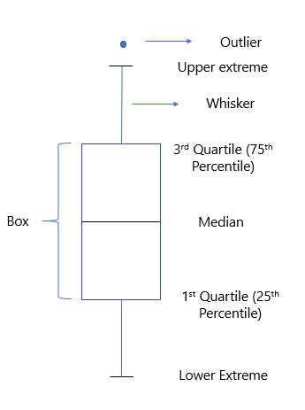
Boxplots
Outliers Analysis with Boxplots:
Understanding the spread of numeric variables and checking extreme values. Identifying and removing extreme values or outliers from the dataset.
This is where you’ll start utilizing visualization to achieve your tasks.
And the visualization best suited for this is the box plot.
Outliers in data can arise due to genuine reasons or because of dubious entries. In the latter case, you should go ahead and remove such entries immediately. Use a boxplot to observe, analyze and remove them.

Slide 30
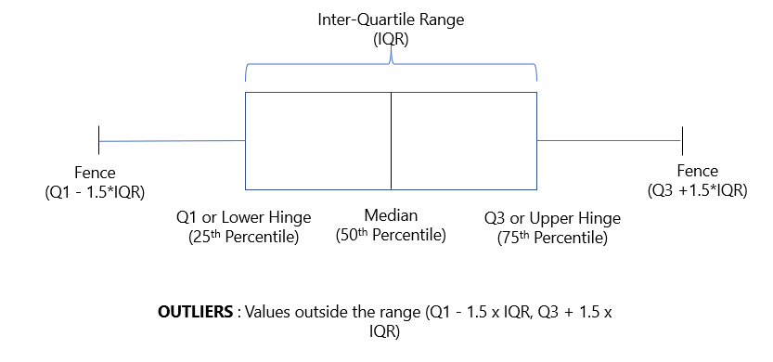
Boxplots
The ‘maximum’ and ‘minimum’ values, which are represented by the fences of the box plot, are given by the formula Q3 + 1.5*IQR and Q1-1.5*IQR, respectively.
Any value lying outside this range would be treated as an outlier.
[Here IQR or the interquartile range denotes the values that lie between the 25th and 75th percentiles.]
Values that are outside the range are outliers.

Slide 31
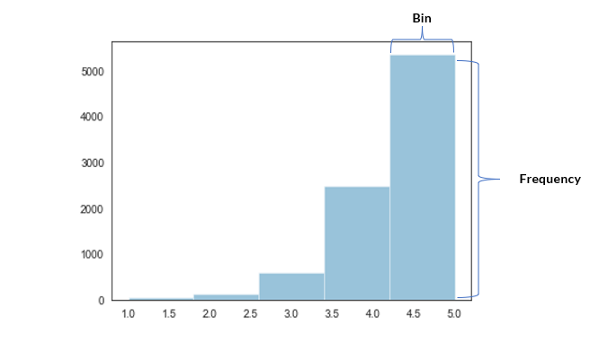
Histograms
histograms generally work by bucketing the entire range of values that a particular variable takes to specific bins.
After that, it uses vertical bars to denote the total number of records in a specific bin, which is also known as its frequency.
histograms are used for analyzing a numeric variable by dividing them into certain bins and then finding the frequency, or the number of records in each bin.

Slide 32
Histograms
code:
plt.figure(figsize=(15,5))
plt.hist(column, bins=7, histtype='bar',align='mid', color='c', label=‘name’, edgecolor='black’)
plt.show()
In Matplotlib, we use the hist() function to create histograms.
The hist() function will use an array of numbers to create a histogram, the array is sent into the function as an argument.

Slide 33

Seaborn
Seaborn: Data visualization with Seaborn library.
Seaborn is a library that uses Matplotlib underneath to plot graphs. It will be used to visualize random distributions.
Seaborn is a library for making statistical graphics in Python. It builds on top of Matplotlib and integrates closely with pandas data structures.
Seaborn helps you explore and understand your data. Its plotting functions operate on data frames and arrays containing whole datasets and internally perform the necessary semantic mapping and statistical aggregation to produce informative plots.
Import the Seaborn module in your code using the following statement:
import seaborn as sns

Slide 34
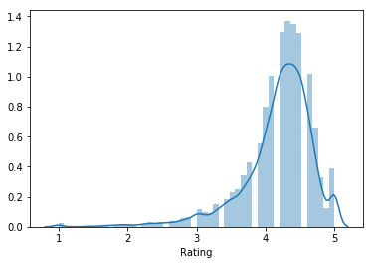
Distribution Plots
Here you must have noticed that instead of the hist command, you are now using a distplot or a distribution plot.
code:
sns.distplot(df.column)
The difference arises because instead of calculating the ‘frequency’, the distplot in Seaborn directly computes the probability density for the bucket.
And the curve that gets drawn over the distribution is the approximate probability density curve.
For example, the maximum frequency occurs around the 4-4.5 bucket in the histogram plotted by matplotlib. Similarly, the maximum density also lies in the 4-4.5 bucket in the distplot.

Slide 35
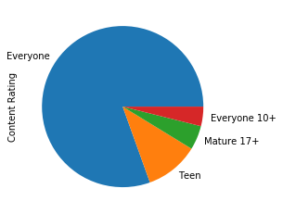
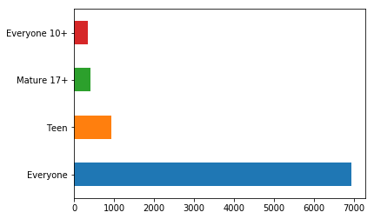
Pie - Chart and Bar Chart
Analyzing the categorical variables.
Note that in the case of categorical variables, you need to use aggregates or measures like sum, average and median to plot the visualizations.
And then use plots like a bar chart or pie chart to portray those relationships.
For analyzing how a numeric variable changes across several categories of a categorical variable you utilize either a pie chart or a box plot.
pie chart is not very much preferred in cases where there are 3 more categories to be plotted.
This problem is easily overcome with the bar graph.

Slide 36
Pie - Chart and Bar Chart
Pie plot
Bar plot
code:
df.column.value_counts().plot.pie()
plt.show()
code:
df.column.value_counts().plot.bar()
plt.xlabel('name', fontsize=16)
plt.ylabel('name', fontsize=16)
plt.title('name',fontsize=20)
plt.show()

Slide 37
Scatter Plots:
What about two numeric columns, If you want to plot the relationship between two numeric variables, you will be using something known as a scatterplot.
one variable on the x-axis. and another one on the y axis.
Scatterplots are perhaps one of the most commonly used as well one of the most powerful visualizations you can use in the field of machine learning.
They are pretty crucial in revealing relationships between the data points.
code:
plt.figure(figsize=(10,10))
sns.scatterplot(data=data_set_name, x="col_name", y="col_name", hue="time")
plt.xlabel('name', fontsize=16)
plt.ylabel('name', fontsize=16)
plt.title('name',fontsize=20)
plt.show()

Slide 38
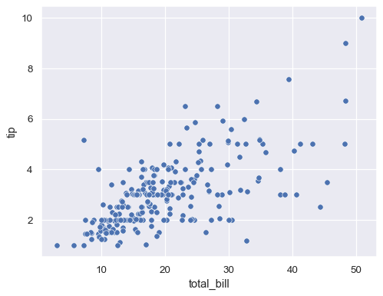
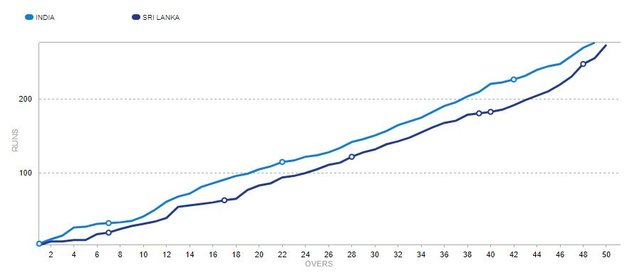

Slide 39
Line Plot
Line chart is used when you want to emphasize changes in values for one variable (plotted on the vertical axis) for continuous values of a second variable (plotted on the horizontal).
On the horizontal axis, you need a variable that depicts continuous values that have a regular interval of measurement - like minute, hour, day, week, or month etc.,
On the vertical axis, you will report the value of a second numeric variable for points that fall in each of the intervals defined by the horizontal-axis variable.
code:
plt.figure(figsize=(10,10))
sns.lineplot(x="col_1", y="col_2",data=df)
plt.xlabel('name', fontsize=16)
plt.ylabel('name', fontsize=16)
plt.title('name',fontsize=20)
plt.show()

Slide 40
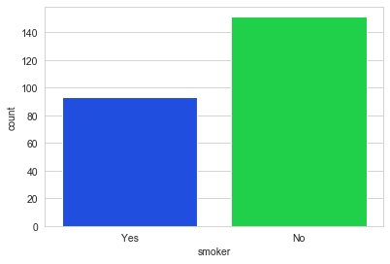
Count Plot
A count plot can be thought of as a histogram across a categorical, instead of quantitative, variable.
Count plot lets us easily plot a feature against the number of observations or occurrences. It is like plotting the frequency of the values in a column.
code:
plt.figure(figsize=(10,10))
sns.set_theme(style="darkgrid")
titanic = sns.load_dataset("titanic")
count = sns.countplot(x="class", data=titanic)
plt.xlabel('name', fontsize=16)
plt.ylabel('name', fontsize=16)
plt.title('name',fontsize=20)
plt.show()

Slide 41
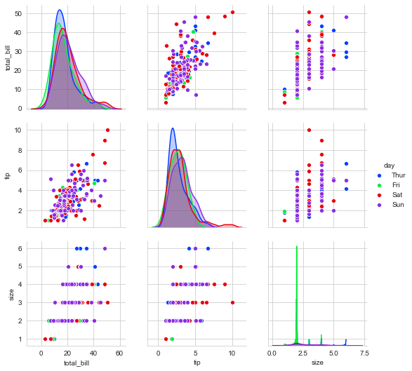
Pair plots
One of the simplest ways to visualize the relation between all features, the pair plot method plots all the pair relationships in the dataset at once.
Plot pairwise relationships in a dataset. By default, this function will create a grid of Axes such that each numeric variable in data will be shared across the y-axis across a single row and the x-axis across a single column.
The diagonal plots are treated differently: a univariate distribution plot is drawn to show the marginal distribution of the data in each column.
It is also possible to show a subset of variables or plot different variables on the rows and columns.
code:
plt.figure(dpi = 1200)
sns.pairplot(df)

Slide 42
Seaborn correlation heatmap
A heatmap is one of the components supported by seaborn where variation in related data is portrayed using a color palette.
A correlation heatmap is a heatmap that shows a 2D correlation matrix between two discrete dimensions, using colored cells to represent data from usually a monochromatic scale.
This makes correlation heatmaps ideal for data analysis since it makes patterns easily readable and highlights the differences and variations in the same data.
A correlation heatmap, like a regular heatmap, is assisted by a color bar making data easily readable and comprehensible.
The data here has to be passed with the corr() method to generate a correlation heatmap.
Also, corr() itself eliminates columns that will be of no use while generating a correlation heatmap and selects those which can be used.

Slide 43
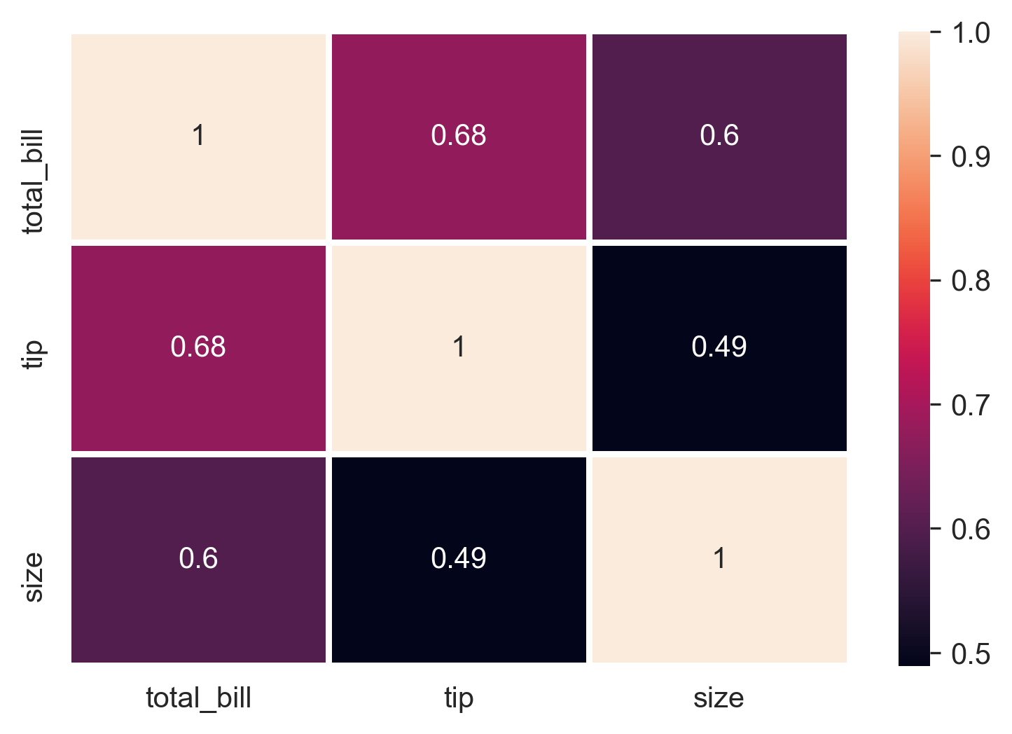
Seaborn correlation heatmap
Correlation Matrix with Heatmap:
Correlation states how the features are related to each other or the target variable.
Correlation can be positive (increase in one value of feature increases the value of the target variable) or negative (increase in one value of feature decreases the value of the target variable)
Heatmap makes it easy to identify which features are most related to the target variable, we will plot heatmap of correlated features using the seaborn library.

Slide 44
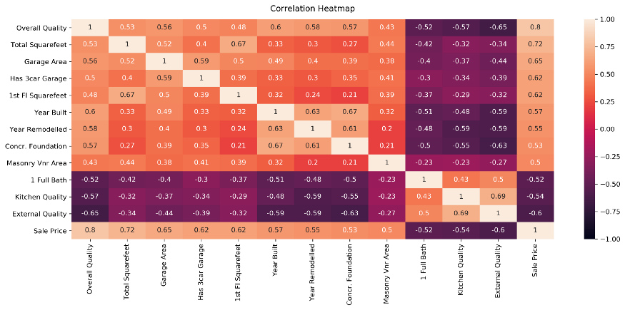
Seaborn correlation heatmap
code:
import seaborn as sns
get correlations of each features in
datasetcorrmat = data.corr()
plt.figure(figsize=(20,20))
map= sns.heatmap(corrmat,annot=True,cmap="RdYlGn")
title to the heatmap.
heatmap.set_title('Correlation Heatmap', fontdict={'fontsize':12}, pad=12)

Slide 45

THANK YOU

